Slide 1
Avocado Price
Forecast
Ziying Yan, Yunfei Hao, Danli Hu, Haoning Deng, Zidi Wang, Yinan Qi

Slide 2

01
Introduction

Slide 3
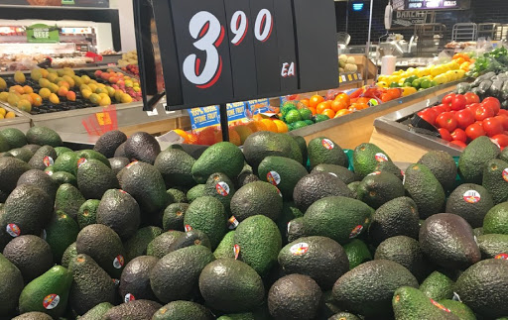
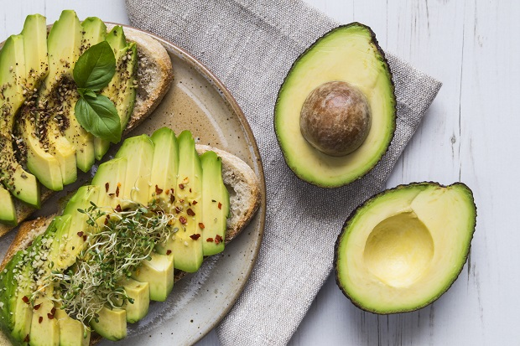
Background and Purpose
Lucrative market of avocado
1.Avocado is very profitable in the US domestic and international markets.
2.Promoted by a growing Latino community and Hollywood stars promoting the unsaturated fats contained in this fruit, the avocado mania in the United States has increased year by year
3.A shocking figure: A few weeks before the Super Bowl in January, Americans bought about 13.5 million pounds of avocado.
Objective of Analysis
Our project is to predict avocado price and help merchants better determine their stock and price.

Slide 4
Dataset
The avocado dataset contains weekly 2018 retail scan data for National retail volume (units) and price.
Use predictors to do the price forecast
Shape
# (18249,14)
N/A
# There isn't any NULL variable
Variables
Data type | Variable names | Notes
Int64 | year
float64 | AveragePrice,TotalVolume 4046, 4225, 4770 Total Bags, Small Bags, Large Bags, XLarge Bags | # 4046, 4225, 4770 - total number of avocado of certain type sold
object | Date, type, region | # type - conventional or organic
Notes:
# AveragePrice - the average price of a single avocado
# Total Volume - Total number of avocados sold
# type - conventional or organic
# Region - the city or region of the observation
# 4046 - Total number of avocados with PLU 4046 sold (Small Hass)
# 4225 - Total number of avocados with PLU 4225 sold (Large Hass)
# 4770 - Total number of avocados with PLU 4770 sold (XLarge Hass)
# Bags: undefined, could be the number of bags of all sizes

Slide 5

What is 4046 4225 4770？
Size & Product Look Up Code
#4046 Small & Medium Hass Avocado (~3-5oz)
#4225 Large Hass Avocado(~8-10oz)
#4770 Extra Large Hass Avocado(~10-15oz)

Slide 6
Preprocessing
[For Descriptive]
About region
Divide all regions to two categories:
City level (e.g. New York) and Regional level (e.g. GreatLakes)
[For Modeling]
Extract Month from Date, Delete Date, Add Season Dummies
(Spring, Summer, Autumn, Winter)
Two methods: dummies and label encoding
About time
About region

Slide 7
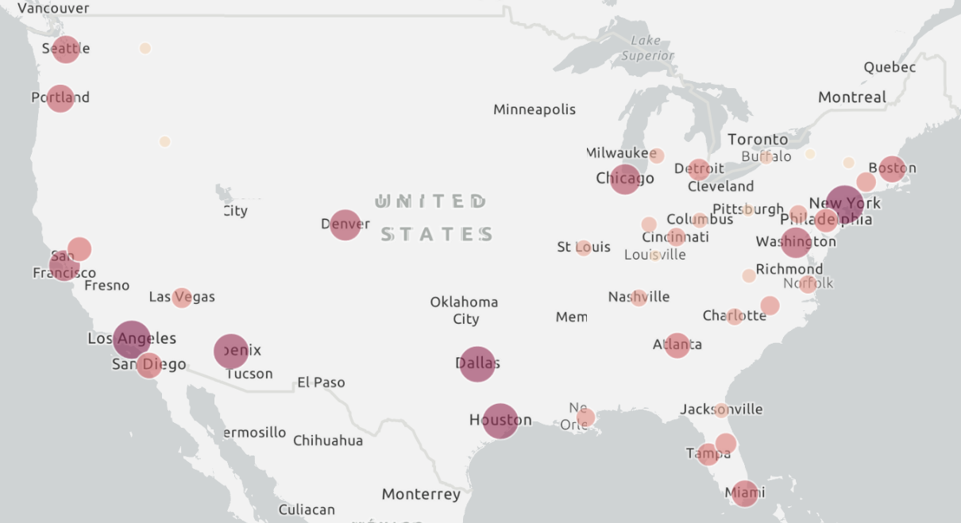
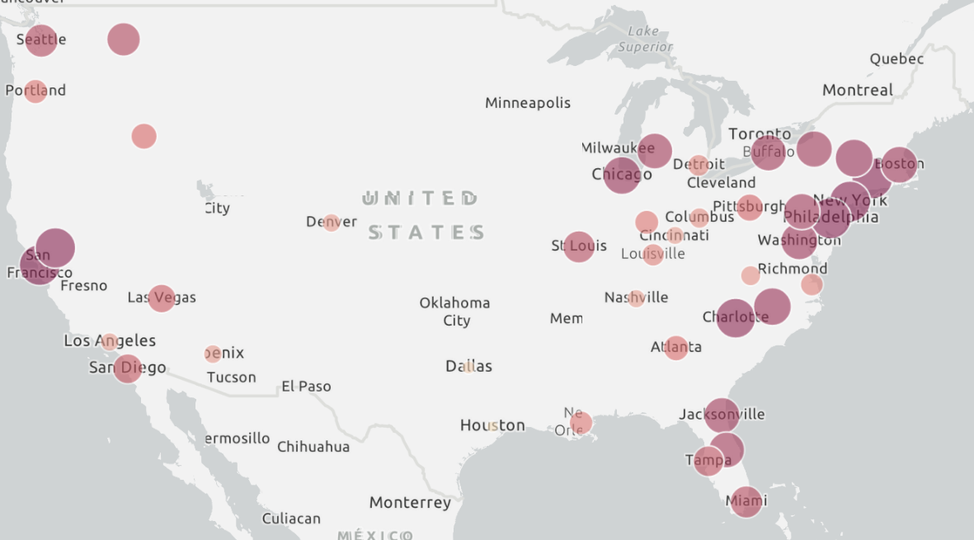
Regional Distribution
Total Sales
Average Price
Denver
Dallas
Houston
For total sales, Western, Northeastern and Mid-south have the largest amount, indicating the popularity of avocado
Northeastern has the highest average price

Slide 8
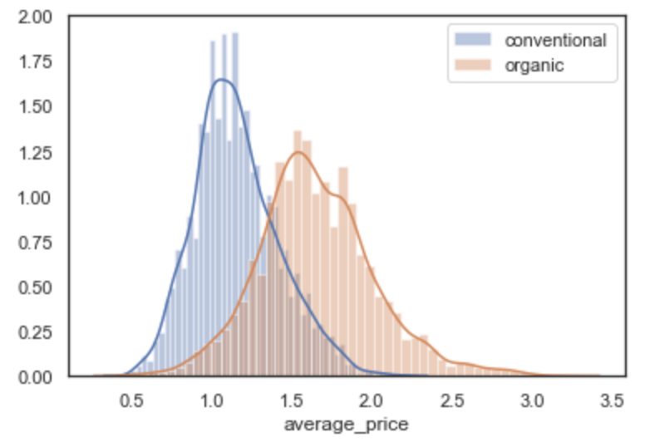
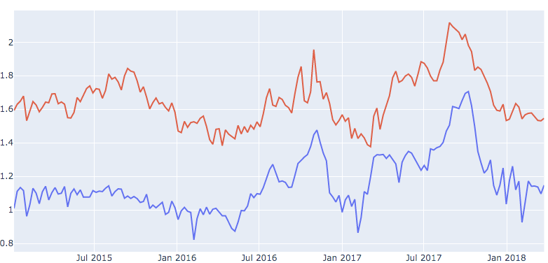
Type Distribution
Average price distribution
Average Price change through time

Slide 9
02
Machine Learning Methods Forecasting
Random Forest & XGBoost

Slide 10
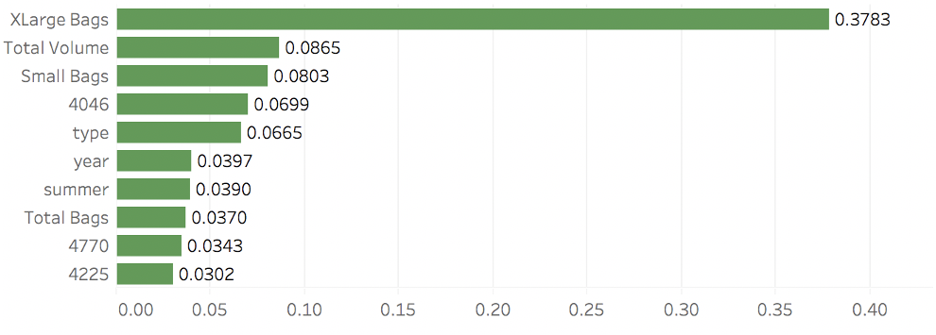
Feature Importance
Random Forest
Notes:
We ran random forest and XGboost simultaneously, and compared the results and RMSE of both model. The first model is random forest, as we can see in the chart of feature importance, xlarge bags, total volume, small bags and avocado 4046 are the most important variables.

Slide 11
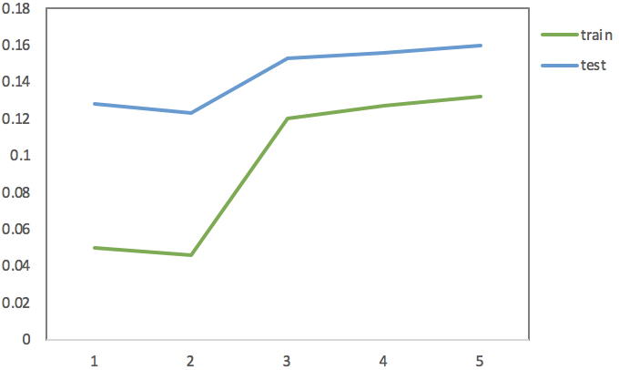
RMSE Results
Random Forest
train-rmse-mean | 0.13168
train-rmse-std | 0.0007
test-rmse-mean | 0.15557
test-rmse-std | 0.0045
Notes:
We used RMSE to verify experimental results. This plot shows the RMSE result of randomforest, we can see a large gap between rmse of train and test, which shows that there could be a potential overfitting problem.
After tuning parameters, the model as a lower and stable standard deviation, which means that this model yield stable result. After tuning, we solved the potential overfitting problem

Slide 12
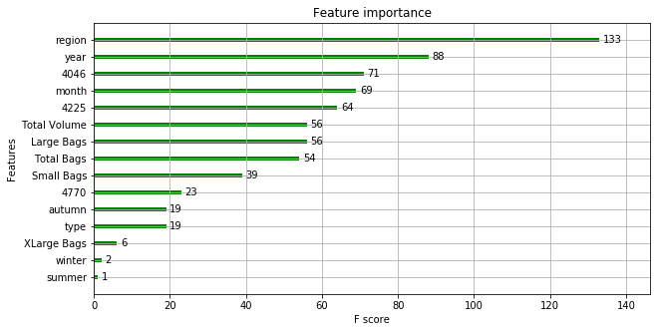
Feature Importance
XGBoost
Notes:
The second model we used to analyze this dataset is XGBoost model,
Here is the feature importance shart for XGBoost model, in this model, region is the most important variable which influences the average avocado price, followed by year and avocado type 4046.

Slide 13
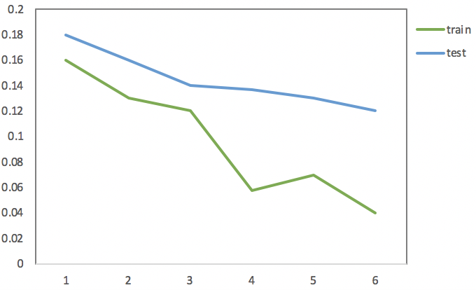
RMSE Results
XGBoost
train-rmse-mean | 0.0447
train-rmse-std | 0.0006
test-rmse-mean | 0.1267
test-rmse-std | 0.0009
Notes:
we used RMSE to verify experimental results. This plot shows the RMSE result of XGBoost, we can see a relative large gap between rmse of train and test.
After tuning parameters, the model as a low standard deviation, which means that our prediction result is stable. You can see from the line chart that the RMSE of train and test gets lower after tuning.

Slide 14
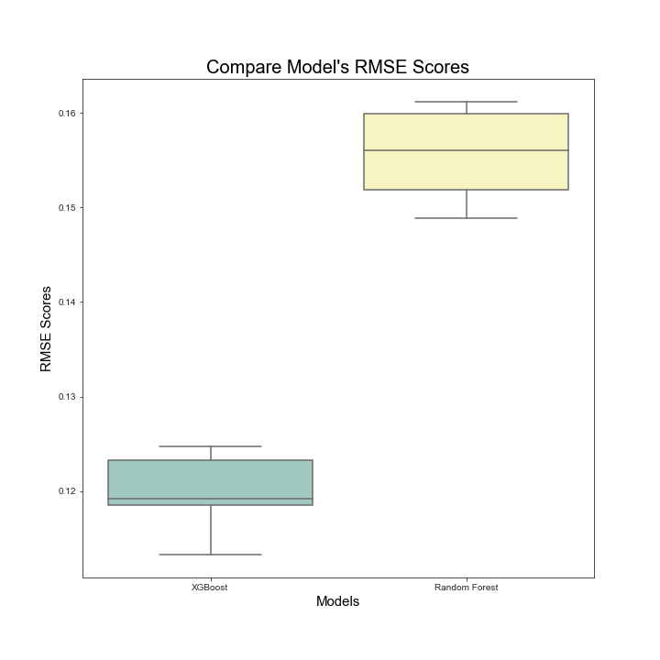
Model Comparison
Test Final RMSE: 0.117
Notes:
After parameter tuning, we used 10 fold cross validation to get the RMSE both from the optimized random forest and XGBoost models.
Based on the blox chart above, compared RMSE of these two models, it is clear that XGBoost has lower RMSE score than random forest, also the XGBoost has a more stable RMSE compared with random forest.
Therefore, we conclude that comparing the optimized models, XGBoost performs better than random forest. The result of predicting test dataset reached 0.117 using the optimized XGBoost model, which is satisfying for us.

Slide 15
03
Exploration

Slide 16
The other method we tried
Time Series Forecasting
-Time Series Forecasting is an application of Supervised Training.
-We build a model to predict value from date, with past data as training data.
-By feeding the model with future dates, it will produce forecasted values for the future dates.
Notes:
Look at the avocado dataset, (it contains the variable date and from the descriptive statistics we know that there seem to exist some pattern of time, )we can’t help gave it a try of Time Series Analysis.
Since we haven’t talked about Time Series Analysis in any of our course, we explored some packages and softwares and learned through trial and error.
In general time series can be divided in 3 steps
-Time Series Forecasting is an application of Supervised Training.
-We build a model to predict value from date, with past data as training data.
-By feeding the model with future dates, it will produce forecasted values for the future.

Slide 17
Our Trial and Error
with Time Series Analysis
Traditional
Facebook
Time Series Forecasting
Traditional Approach
Prophet
Builds a model that predicts a day’s value from past N days.
(Professor PK’s VMWare case)
Open source Time Series Forecasting Algorithm from Facebook.
Notes:
Before we look at our result, I want to say that there is a difference between Traditional approach and the package we used called Prophet.
Traditional way of doing time series has some limitations( such as Time interval between data has to be the same, or Day with NA is not allowed, also we were not able to pick up all the parameter tuning skills within the given period of time.
On the other hand) While Prophet is designed by Facebook for ease of use. (For people without expert knowledge, it’s a choice. So we made a bit of Trial and Error with Prophet in Python.)

Slide 18
Our Trial and Error
with Time Series Analysis
Time series package prophet
Prophet is open source software released by Facebook's Core Data Science team.
Step 1 : Initialize a Prophet object
Step 2: Call the fit method, estimate unknowns in the model
Step 3: Extract and Interpret results
Notes:
Prophet is not complicated.
The usage is almost the same with PCA and EFA. So I believe that we all can pick it up very soon.
It is a powerful package, there are functions with which you can estimate, evaluate, and visualize.
(Prophet includes functionality for time series cross validation to measure forecast error using historical data.
It deals with outliers, NA, seasonality, etc
If you are interested, go explore, and welcome to talk about time series anytime with me.)
If you are interested in self-leaering of time series analysis please feel free to contact with me

Slide 19

Our Trial and Error
with Time Series Analysis
Visualization tool- prophet
Notes:
The other Times Series Analysis tool i want to introduce is called “Exploratory”.
Inside this software you can call Prophet function, and it provide you with versatile, easy to access charts.

Slide 20
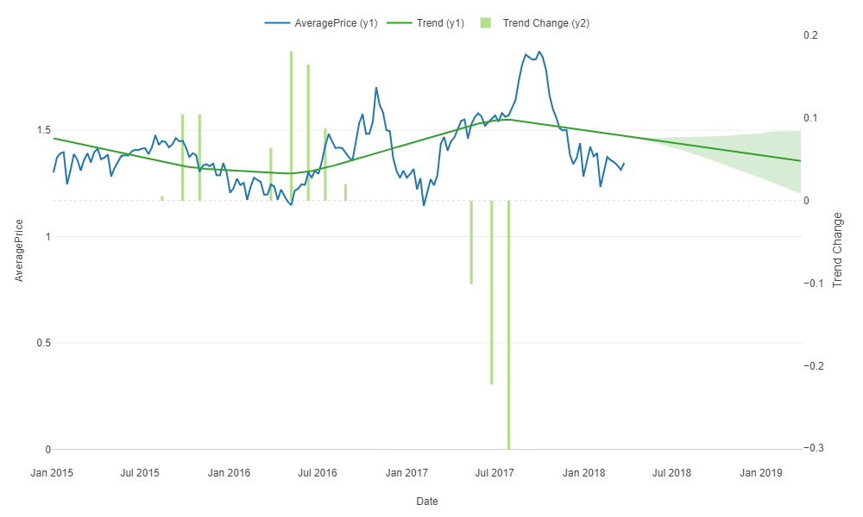
Analysis
Notes:
Here is one of the chart generated by Exploratory using Prophet.
X axis represents date, Y axis represents average price and trend change.
Blue line describes the actual average price through years.
The green line indicates that overall trend of price change. We can see that the avocado price is more likely to go down in the next 12 month.
To notice that here we set the confidence interval to 95%. So there is a chance the price will go up. 【用鼠标指向尾巴的地方】
The vertical green bars displays change points of the trend line, and how much change of slope was made at each change point.

Slide 21
Markets with price dropping
Markets with price rising
55.56%
44.44%
Notes:
We predict the average price of the future 12 months for every single market.
(According to the prediction from Exploratory,) slightly more than half of the regions will have an increase in average price in the next year, while places that are likely to have a decrease in avocado price accounts for 44%.
Will the locations of theses regions be inspiring?
Let’s try visualize them!

Slide 22
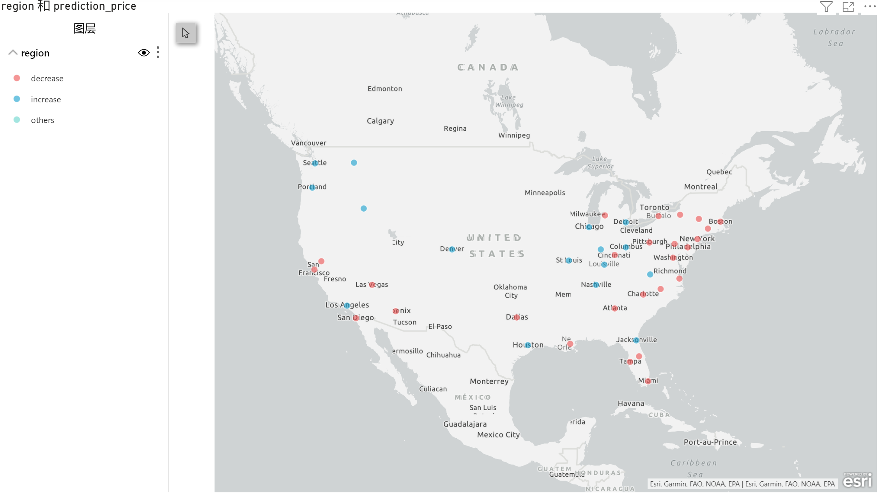
Spokane
Boise
Notes:
This is made from the Arc GIS map of PowerBI.
Red point indicates a decrease in price
Blue plints indicates an increase in price
We can see that for the next 12 months cities with decrease in price intensively locate at Northeastt and South West. While North West, GreatLakes and Middle South’s market tend to have a decrease in price.
Again Why is that ?
Peru and Mexico are the largest Avocado exporters, they are both in South America
If you want to get made in US avocado, they are grown in California and Florida.
Maybe the closer you are from the producer, the less price you want to pay for the fruits.
Some geographical, weather, geopolitical and people’s lifestyle change might lead to the future change of price.

Slide 23
04
Recommendation
Notes:
Here are some advice for people who are dealing with avocado busienss

Slide 24
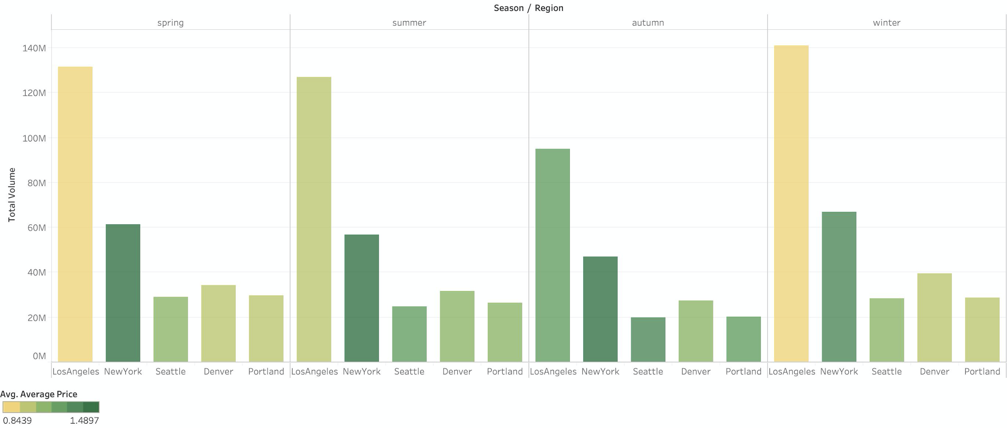
Conventional
Spring Summer Autumn Winter
Total Volume
Notes:
带着大家解读这张表本身：
聚焦于Conventional的果子，
我们measure了不同地区销量、均价随着季节是如何变化的。
Bar越高代表销量越高
颜色越绿代表均价越贵，越黄代表均价越便宜
In terms of city, 总的来说，洛杉矶人消费conventional avocado最多
In terms of season, 秋季果子销量普遍下降，冬季和春季销量较高
In terms of price, 纽约的果子最贵，其次是洛杉矶，凤凰城的果子最便宜
Lets focus on Conventional Avocado first.
This graph indicates how the volume and price of avocado of major cities change through seasons.
The higher the bar is, the more avocado is sold.
The greener the color is, the more expensive the average price of avocado is.
Four blocks represent “春”夏”秋”冬“
From the chart we can see that in terms of season, people buy more fruits in winter and spring, while they tend to pruchase less in autumn.
IN terms of city, people in LA purchased on average the largest amount of conventional avocado.
IN terms of price, New York’s conventional avocado could be almost twice as expensive as those in Los Angeles. But in autumn there is a shrinkage in the gap

Slide 25
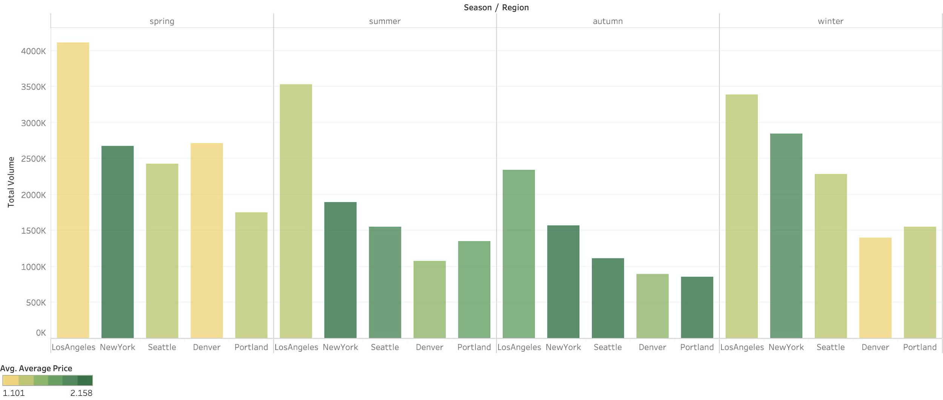
Organic
Spring Summer Autumn Winter
Total Volume
Notes:
解读方法同上图，注意这里是Organic的果子
What about Organic fruit
From the chart we can see that similiar to conventional avocado in the previous slide, autumn seem to be a slack season.
IN terms of city, people in LA and New York are again the big buyers.
IN terms of price, New York’s organic avocado is again the most expensive.

Slide 26
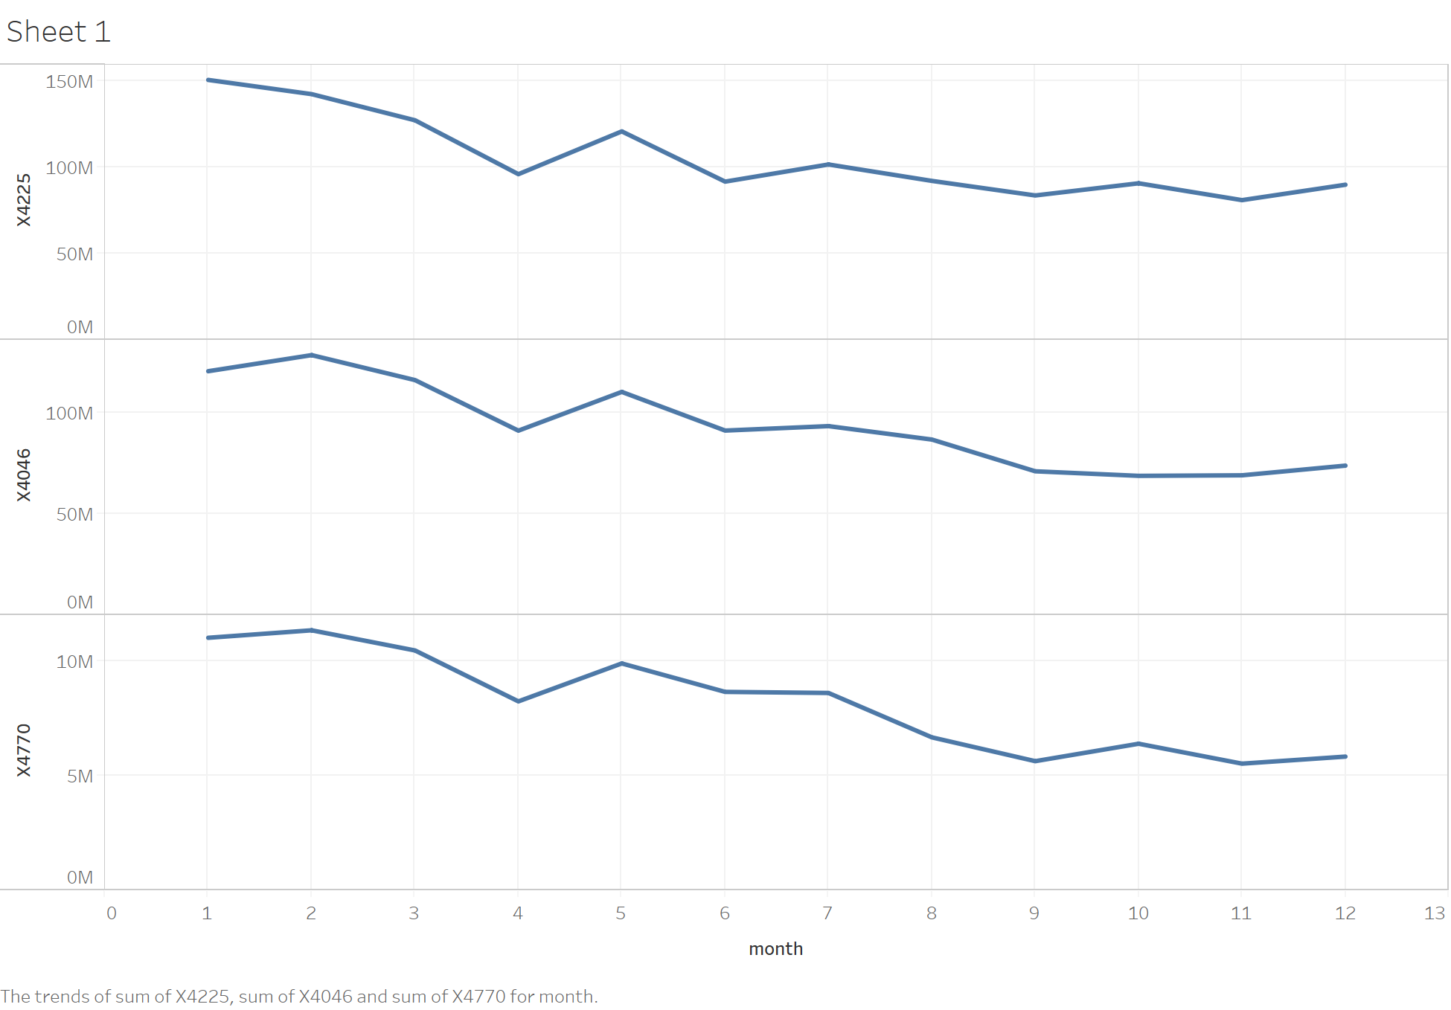
4225
(small
fruit)
4046
(medium
fruit)
4770
(large
fruit)
Month
Notes:
In Previous slides we discuss the demand of total volume though times
In detail, Lets look at whether there is seasonal demand change of specific size of avocado.From the chart we can see that
People’s demand of specific size of Avocado won’t change much through seasons

Slide 27
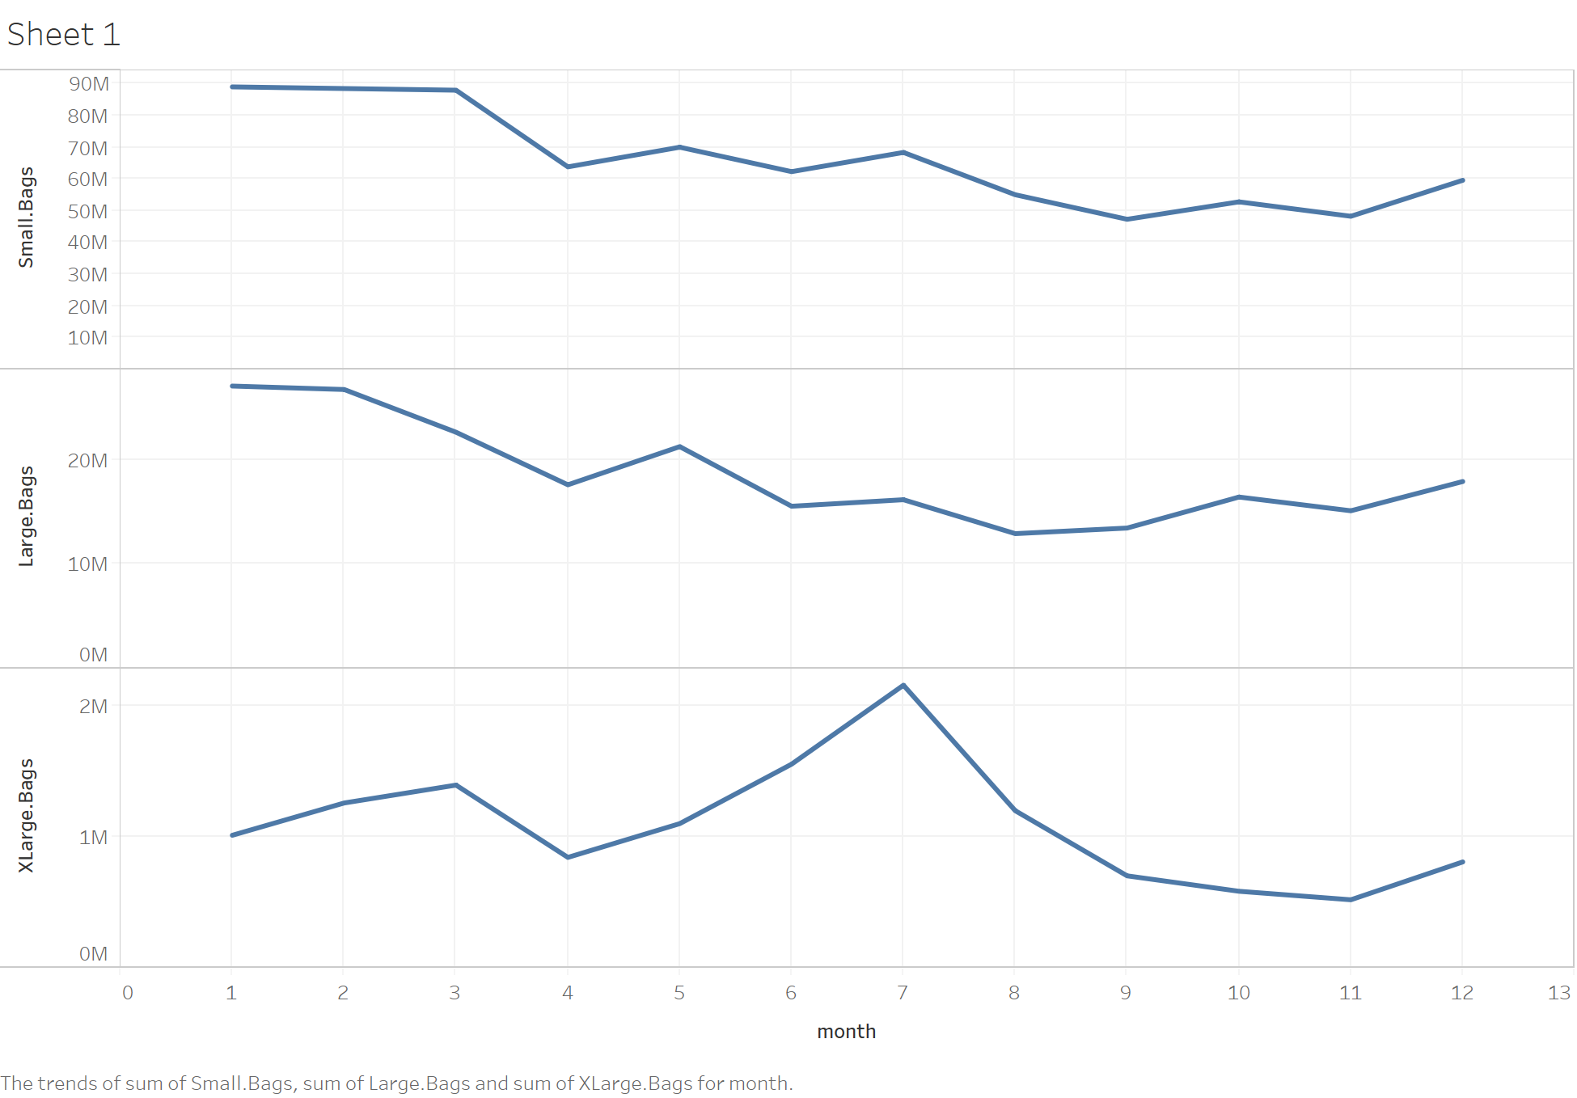
Small Bags
Large Bags
XLarge Bags
Month
Notes:
But their demand of Extra large bags doubled in Summer!!!
So If you are dealing with avocado business, consider extra large bags in summer

Slide 28
Recommendation
Size
Bag
Models can be useful, but it needs to be adjusted based on the changing situation.
4046-Los Angeles
4225-New York
4770- Chicago
Small- California
Large-Great Lakes
XLarge-Great Lakes
Notes:
-Which size of avocado should you sell?
In Los Angeles, we recommend to sell avocado 4225 （smallest size）. In New York, 4046（middle size） will be your best choice. If your business is in Chicago maybe 4770(Large size) will be your first choice.
-Which type of avocado should you sell?
No matter organic or conventional, Losangeles and Newyork consumed more avocado than other cites. To balance between these two cities, Los Agneles consumes more avocado with lower price becuase it’s close to the producer. WHile NewYork sell more expensive avocado.
-Which kind of bags should you consider to sell?
If your business is at Great Lakes regions, consder larger bags please. If you are in California, maybe you should avoid making a gigantic bag of avocado.
(XLarge-Great Lakes
Large-Great Lakes
Small- California)
A lot more things can affect the future price of fruit:
Just as in 2018 you woundn’t have expected a pendemic could be statistically significant in anything’s price.
MOdels could be useful but Don’t rely completely on them.

